Slide 1



RNS INSTITUTE OF TECHNOLOGY
BENGALURU - 98
DEPARTMENT OF INFORMATION SCIENCE & ENGINEERING
Presentation on Internship
Quiz Application
Sharanya J
USN: 1RN18IS096
ENMAZ Engineering Services Pvt.Ltd.
Internal Guide
Dr. Mamatha G
Prof, Dept of ISE, RNSIT
External Guide
Mr. Akshay DR
Director, JP Nagar, Bangalore

Slide 2
AGENDA
Abstract
About the Company
Introduction
Literature Survey
Requirements
System Design
Implementation
Methodology
Results
Conclusion and Future Enhancements
References

Slide 3
ABSTRACT
The Quiz Application provides a user friendly, interactive system to take online test in an efficient manner .
The main objective of the application is to efficiently evaluate the user thoroughly through a fully automated system that not only saves lot of time but also gives fast results.
The project is built using Flutter, which is an open-source framework by Google for building beautiful, natively compiled, multi-platform applications from a single codebase
This application consists of multiple-choice questions, with selectable choices for each question. The score is internally calculated for each question based on the choice selected. The correct answer is displayed in case an incorrect option is chosen.
This is a timed quiz, where a time frame is given for each question and the questions have to be answered in the given time. The score is displayed at the end of the quiz.

Slide 4
About the Company
Enmaz Engineering Services Private Limited is a Private incorporated on 02 December 2019. It is classified as Non-govt company and is registered at Registrar of Companies, Bangalore.
Enmaz has a simple yet robust solution that helps any Industry / Factory digitise their workfloor in no time. The products offered will help in remote monitoring, controlling and also analysing any machine parameter or process
The directors of this company are Akshay Ramakrishna Davasam and Devasam Siddananjappa Setty Ramakrishna
Registered address is #75, 2nd cross, 6th main, 3rd phase, j.p.nagar, bangalore 560078
The current status of Enmaz Engineering Services Private Limited is ACTIVE.

Slide 5
INTRODUCTION
Quiz Application is developed to overcome the time-consuming problem of manual system.
This application will check for correct answers and save the examiner’s time.
The aim here is to computerize the manual system and help in saving time and data. This application conducts a quiz in the form of multiple-choice questions.
After the completion of the quiz the application generates test scores for the quiz taken.

Slide 6
This application consists of multiple-choice questions, with selectable choices for each question. The score is internally calculated for each question based on the choice selected.
The correct answer is displayed in case an incorrect option is chosen.
This is a timed quiz, where a time frame is given for each question and the questions have to be answered in the given time. The score is displayed at the end of the quiz.

Slide 7
LITERATURE SURVEY
In Paper [1], the author discussed the importance of assessment and evaluation in the form of quizzes. Most of e-learning platforms provide supporting system to online evaluation and assessment among their features, and in many cases this supporting system include feature, which is automatically graded quiz based on answer that specified in a question’s setting in quiz. The study presents the development and evaluation of online quizzes and investigates whether they could be useful tools to assist students’ learning in university
Paper [2] discussed how Integrated Development Environments (IDEs) provide a convenient standalone solution that supports developers during various phases of software development. The focus in this paper is on Visual Studio IDE. The author instrumented the previously unexplored Visual Studio IDE and tracked the interactions of developers at an industry partner’s software-development department

Slide 8
Paper [3] discussed about cross platform development using Flutter. Cross-platform mobile development today is full of compromise .Flutter is an open-source SDK for creating high-performance, high- fidelity mobile apps for iOS and Android.
Paper [4] discussed about the dilemma of developer - either develop multiple native applications for different operating systems or developing one app that is cross-platform compatible. Flutter is an interesting new alternative. It is a technology that makes it easy for developers to create native-looking apps that can be executed on both the Android and iOS platform.
Paper [5] discussed application development using Flutter. In Flutter, every application is written with the help of Dart. Google has developed and maintained a programming language called Dart. It is extensively used inside Google and it has been verified to have the proficiency to develop enormous web applications, such as AdWords

Slide 9
REQUIREMENTS
Hardware Requirements
The processor used is Intel(R) Core (TM) i5-8265U CPU @ 1.60GHz.
The capacity of Random-Access Memory (RAM) is 4GB.
The capacity of the storage element of disk space is 2.99GB.
The monitor used is HDMI monitor.
The keys available in the keyboard is 104 keys.
Software Requirements
Operating System: Windows 10
Tools: Flutter
Platform or IDE: Visual Studio Code
Network: Internet connection required

Slide 10
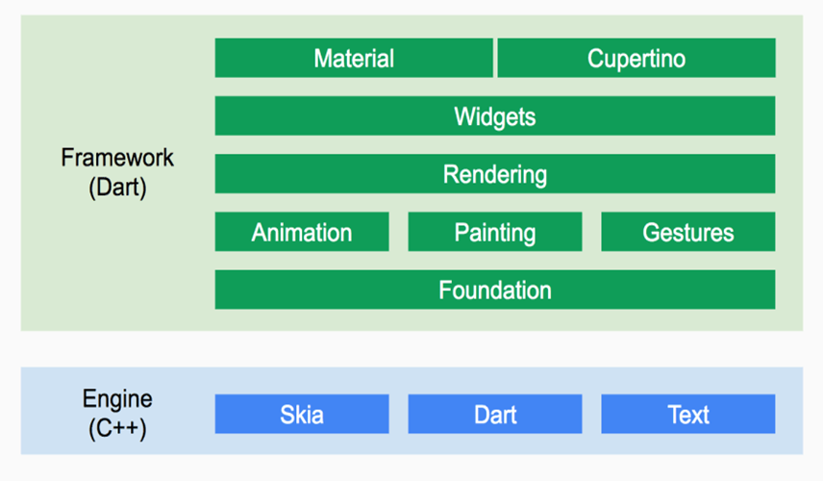
SYSTEM DESIGN

Slide 11
Flutter is organized around layers. Each layer is built upon the previous.
From the diagram, we can see the low-level part of Flutter is an Engine built in C++.
It provides libraries to handle animation, gestures, rendering, widgets and more.
With all this layer the developer can do more with less code by using elements on the top or go down to customize some behavior of its app
Basic building block services and foundational classes, such as animation, gestures, and painting, offer commonly used abstractions over the underlying foundation.
The rendering layer brings forth an abstraction for working with layout and building a tree of renderable objects.

Slide 12
The widgets layer introduces the reactive programming model. Each class in the widgets layer corresponds with a render object in the rendering layer. Besides, the widgets layer allows defining combinations of reusable classes.
The Cupertino and Material libraries provide all-inclusive sets of controls that implement the iOS or Material design languages through the use of the widget layer composition.

Slide 13
Basic Widgets:
In Flutter, everything is a widget nested inside another widget. It comes with beautiful, customizable widgets and we can control the behavior of each widget and also styling becomes easy.
Text
Row
Column
Image
Icon
Scaffold
Button
AppBar
Container

Slide 14
IMPLEMENTATION
About Visual Studio Code
Visual Studio Code is a source-code editor made by Microsoft for Windows, Linux and macOS.
Features include support for debugging, syntax highlighting, intelligent code completion code
refactoring and embedded Git.
About Flutter
Flutter is an open-source UI software development kit created by Google. It is used to develop cross platform applications for Android, iOS, Linux, Mac, Windows, Fuchsia,Web, and the web from a single codebase.

Slide 15
Main.dart file
import 'package:flutter/material.dart';
import 'package:get/get_navigation/src/root/get_material_app.dart';
import 'package:quiz_app/screens/welcome/welcome_screen.dart';
void main() {
runApp(MyApp());
}
class MyApp extends StatelessWidget {
@override
Widget build(BuildContext context) {
return GetMaterialApp(
title: 'Quiz App',
debugShowCheckedModeBanner: false,
theme: ThemeData.dark(),
home: WelcomeScreen(),
); }
This is the main file. The execution starts from main.dart file. The class MyApp extends Stateless Widget and the home property calls the Welcome Screen function

Slide 16
The Questions for the quiz are given in the form of a List, which contains question ID, the question, suitable options for the question and the correct answer for the question.
Question({this.id, this.question, this.answer, this.options});
}
const List sample_data = [
{
"id": 1,
"question": "Flutter is an open-source UI software development kit created by ______",
"options": ['Apple', 'Google', 'Facebook', 'Microsoft'],
"answer_index": 1,
},

Slide 17
The Progress bar is included in the Quiz application which acts as a timer. The user has to answer a question in 60 seconds, otherwise the user is awarded zero mark for that question.
The Progress bar also includes an option called ’Skip’ to skip a question and move to the next question.
After each question, there is a delay of 3 seconds given before the next question is displayed.
Once the last question is displayed, the screen is redirected to the last screen Score screen.
If answer selected by the user is same as the original answer fed into the program, the variable _numOfCorrectAns is incremented. At last, the Score screen function is called to display the scores.

Slide 18
void checkAns(Question question, int selectedIndex) {_isAnswered = true;
_correctAns = question.answer;
_selectedAns = selectedIndex;
if (_correctAns == _selectedAns) _numOfCorrectAns++; // It will stop the counter
_animationController.stop();
update();
// Once user select an ans after 3s it will go to the next qn
Future.delayed(Duration(seconds: 3), () {
nextQuestion();
});
}

Slide 19
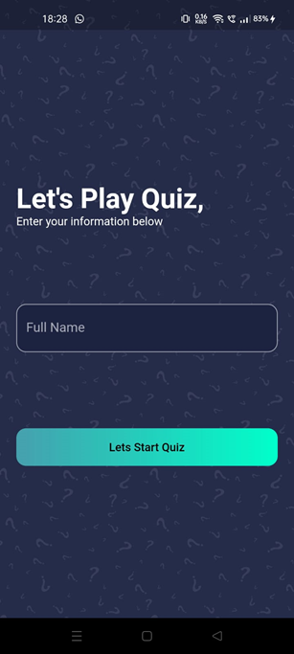
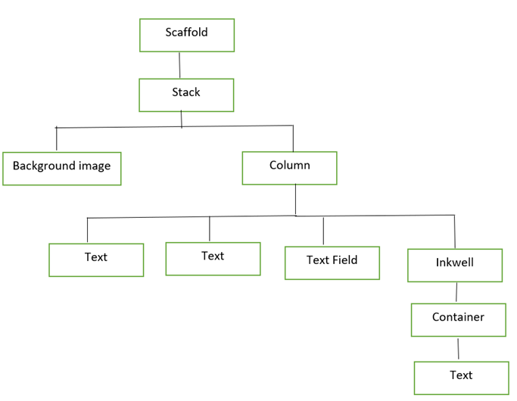
METHODOLOGY
Welcome Screen
Widget tree for Welcome screen
Welcome screen

Slide 20
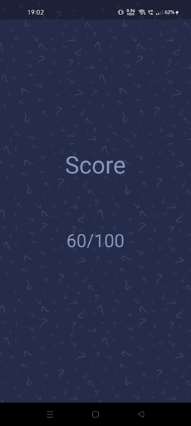
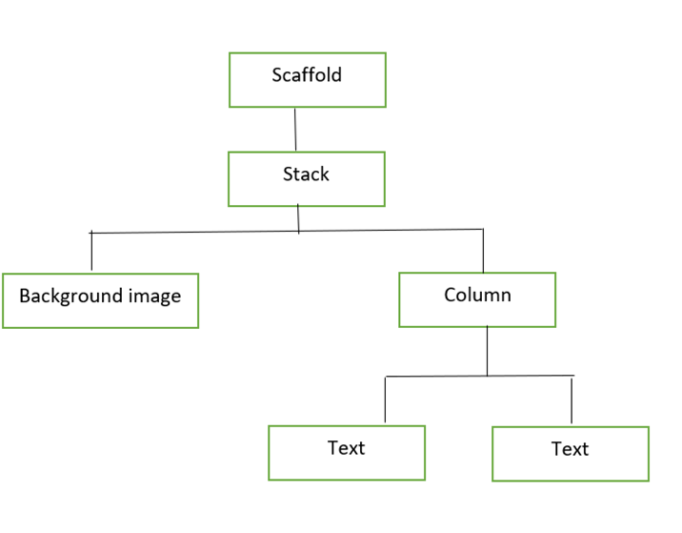
Score Screen
Widget tree for Score screen
Score screen

Slide 21

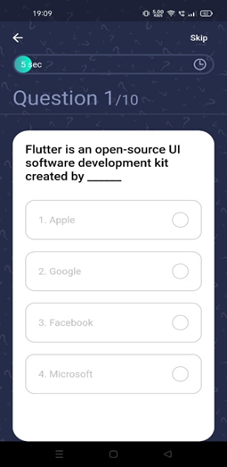
Results
Welcome screen of the application. This is the opening screen, where the user has to continue by providing the Name. On entering the application, the quiz questions are displayed.
The screen displays the question with four options to select from. The timer keeps running for 60 seconds. If no option is selected, then after 60 seconds of timer, next question is displayed.

Slide 22
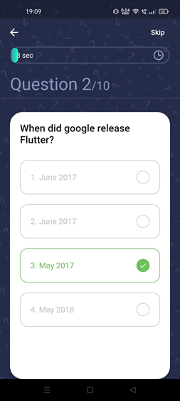
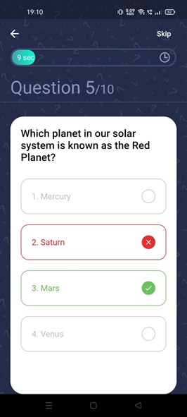
Displays the screen when a correct option for a question is selected. The selected correct answer is highlighted with Green colour and a tick.
When an incorrect option for a question is selected, the selected wrong answer is highlighted with a Red colour and the correct option which should have been selected is highlighted with Green colour

Slide 23
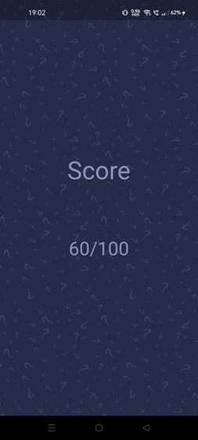
Only six correct answers were selected, hence the score is 60 out of 100. The score in internally calculated and displayed

Slide 24
CONCLUSION
This internship project has been implemented with making appropriate effort to overcome the ­­time-consuming problem of manual system.
It has been successfully designed and implemented using Flutter.
This this application will check the correct answer and save the examiner time and carry the examination in an effective manner.
This application provides facility to play anywhere and anytime. It saves time as the user need not wait for the results. This system reduces paper work and can be used in events for conducting tests.

Slide 25
FUTURE ENHANCEMENTS
In future work the system can be implemented with various quizzes of different topics.
Concept of negative marking can be introduced.
It can be possible to make it more user friendly by adding more variety of functions to it.
A good Internet backup should be automated.
Explanation of correct or wrong answer can be included
Feedback from the user about the game

Slide 26
REFERENCES
[1] https://flutter.dev/
[2] https://code.visualstudio.com/
[3] https://stackoverflow.com/
Reference Papers:
Paper [1]: https://ieeexplore.ieee.org/document/7010585/references#references
Paper [2]: https://ieeexplore.ieee.org/document/7476636
Paper [3]: https://ijesc.org/upload/b3930ac14331fd1b425af8cd1c341d41.Cross%20Platform%20Development%20using%20Flutter%20(1).pdf
Paper [4]: https://www.diva-portal.org/smash/get/diva2:1480395/FULLTEXT01.pdf
Paper [5]: https://www.irjmets.com/uploadedfiles/paper/volume2/issue_8_august_2020/3180/1628083124.pdf

Slide 27
THANK YOU

